Slide 1
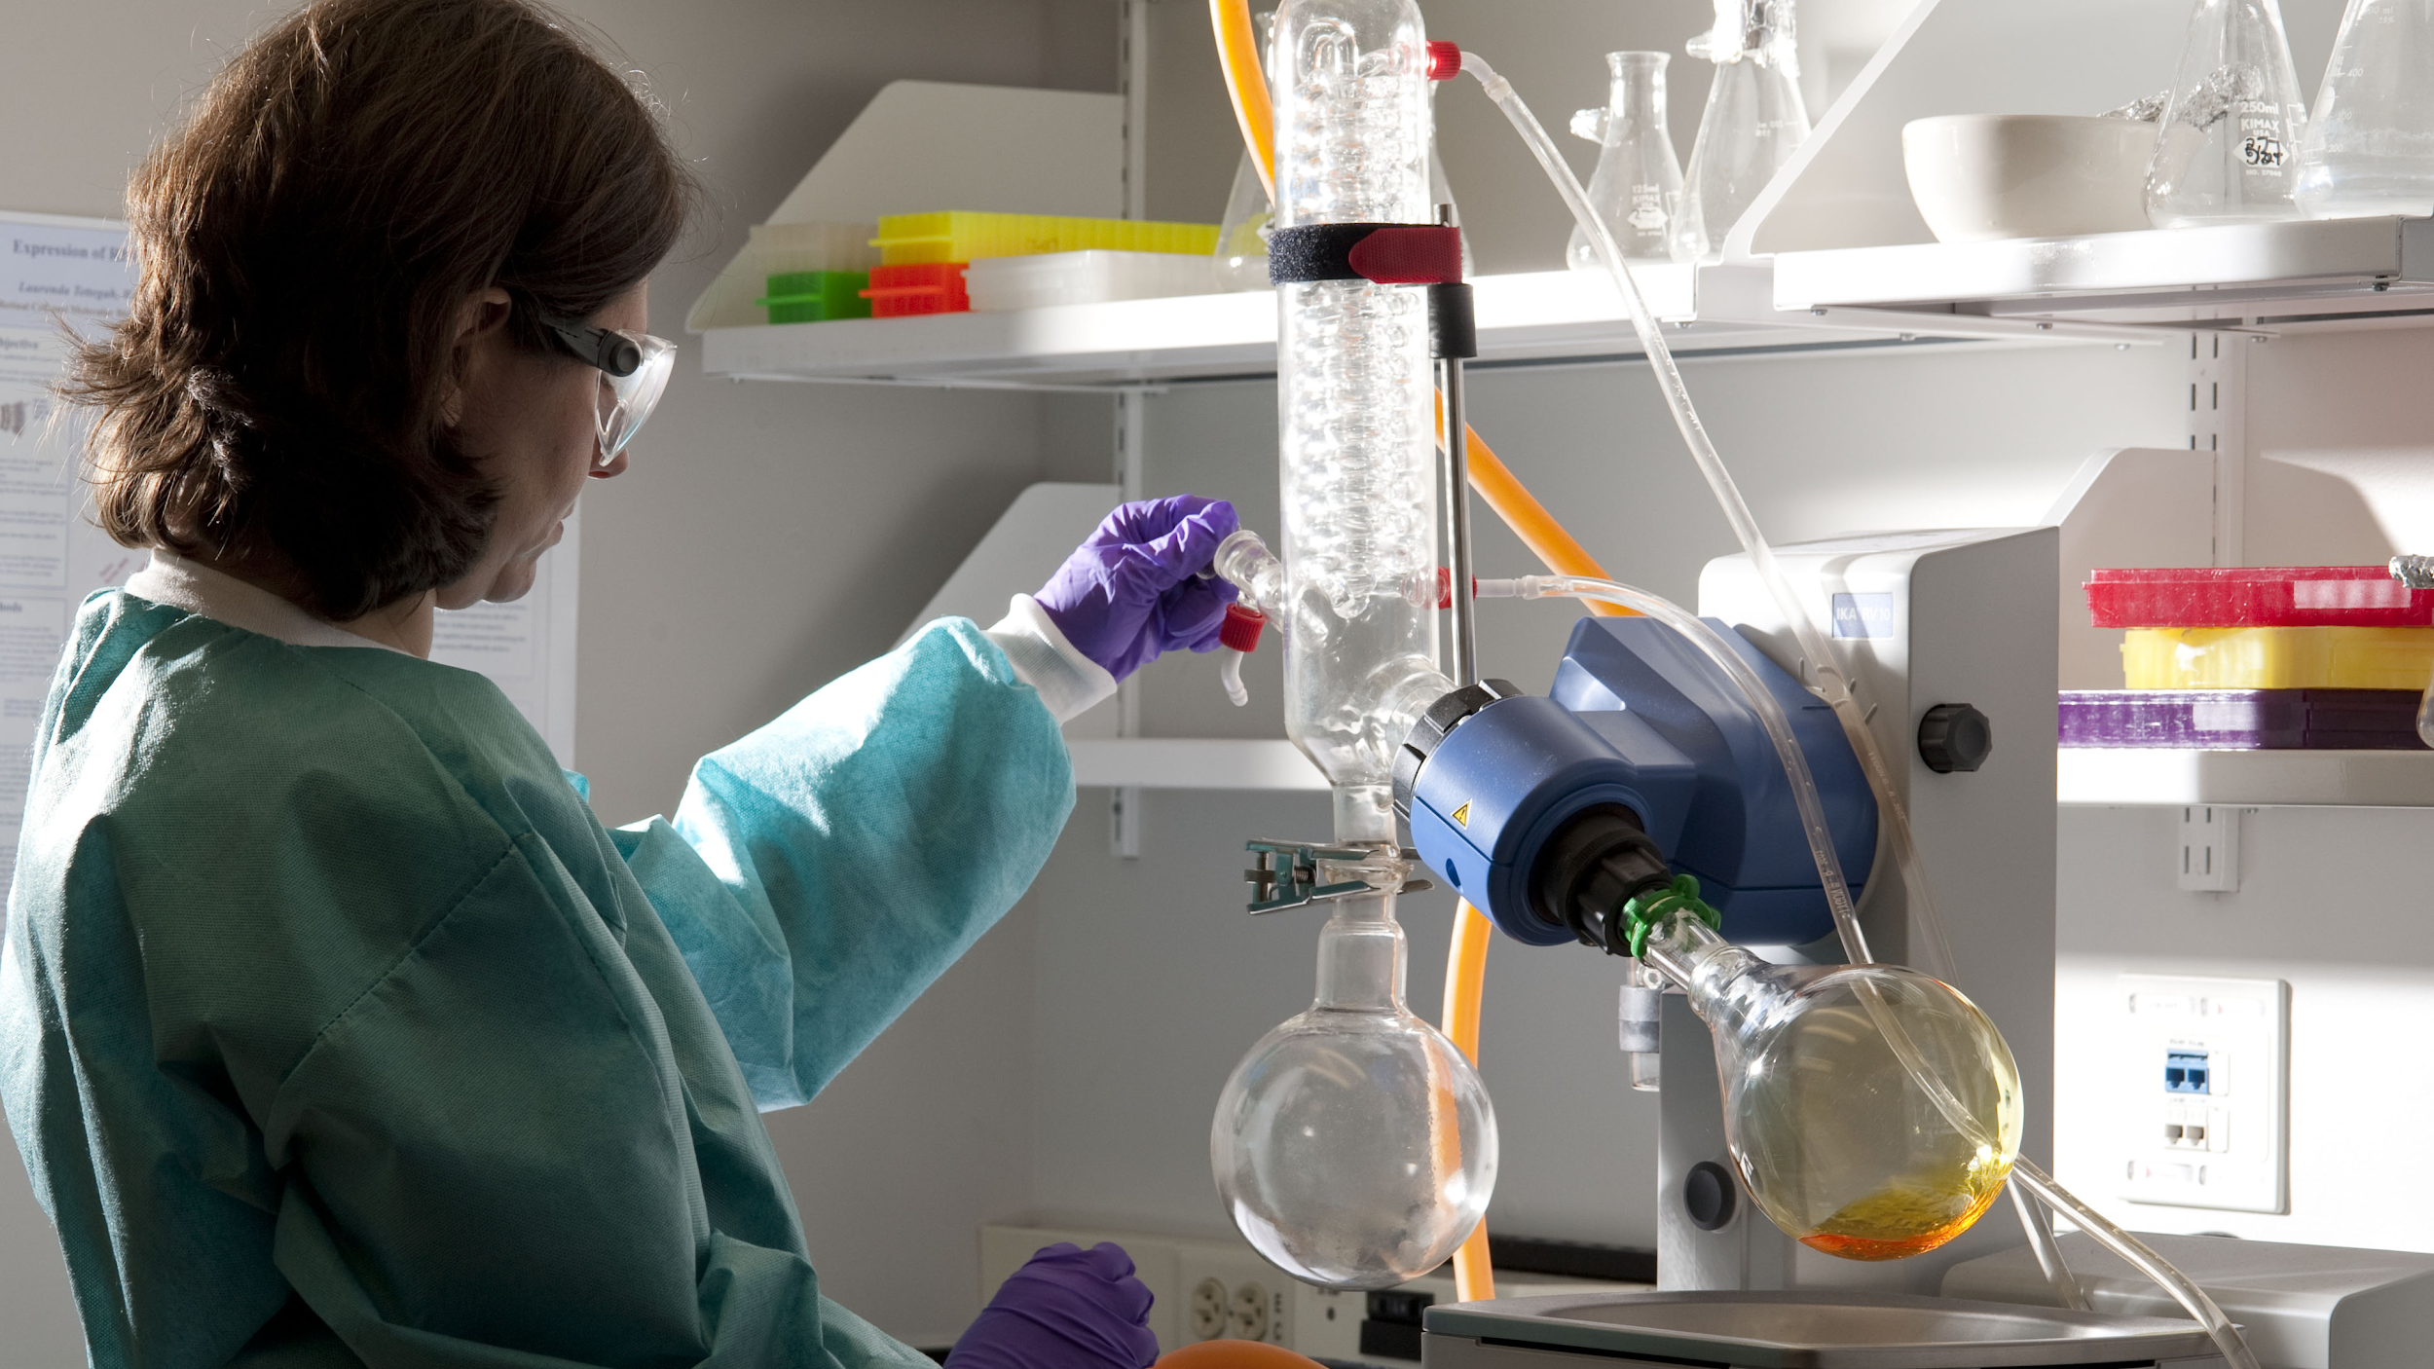
Why Science?
We will identify why we do Science

Slide 2
Do not delete this slide.
This slide is designed so that you can copy the prompt box you need and insert it into your slides.
This slide is hidden and will not be included when presenting your lesson.
TRACK WITH ME
CHECK FOR UNDERSTANDING
VOCABULARY
1 -
HINT
Students, remember….
READ WITH ME
TEACHER CUE
MAKE THE CONNECTION
Students, you already know….
EXTENSION

Slide 3
List as many science occupations as you can.
Chemist
Biologist…

Slide 4
Repeat the opposite word/phrase.
DEMONSTRATE
SHOW WITH ACTION

Slide 5
Repeat the opposite word/phrase.
LABORATORY
ROOM FOR SCIENCE

Slide 6
Repeat the opposite word/phrase.
TRACK WITH ME
READ SILENTLY

Slide 7
Repeat the opposite word/phrase.
READ WITH ME
READ ALOUD

Slide 8
We will explore why we learn Science
TRACK WITH ME
READ WITH ME
We will describe the Science subject
We will separate Science into its branches
We will describe how science and technology impacts our lives
We will describe how scientists help us solve global issues
DECLARE THE OBJECTIVE
Read the learning objective to your partner.
Notes:
Learning Objectives contain concepts (nouns, big ideas), skills (verbs, measurable behaviours) and sometimes context (restricting or targeting conditions).
●Example: Students will be able to describe the concept of density and apply it to floating and sinking.
●
Success criteria are specific measurable outcomes that if met mean that the student has met the learning objective.
Examples:
•Students will be able to compare densities of substances using mass and volume.
•Students will be able to identify whether a solid or liquid will float or sink in a liquid based on their densities.

Slide 9
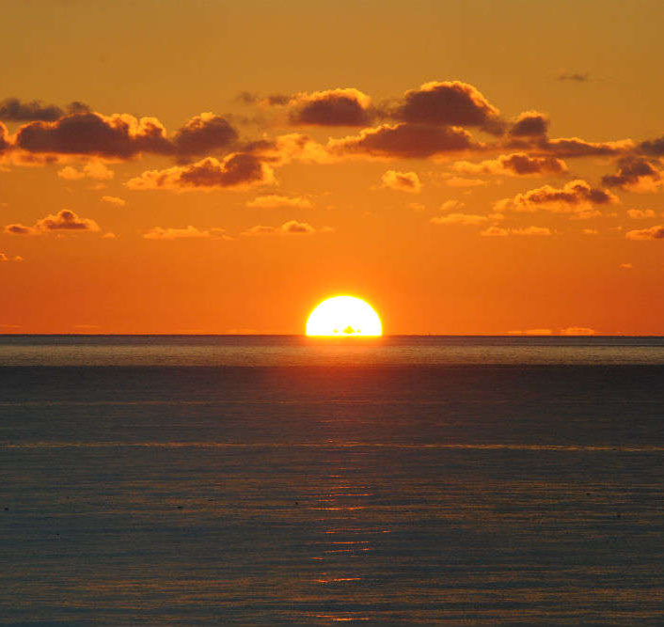
We will explore why we learn Science
What is science?
For thousands of years, people have wondered about how the world works. Not so long ago, people wondered why the sun rises every day, or why a ball falls to the ground when you drop it.
Science has come from people trying to find answers to these questions. In fact, the word science comes from the Latin word "scire", which means to know.
TRACK WITH ME

Slide 10

We will explore why we learn Science
Questions:
Why do people do science?
How has science impacted weather forecasts?
Notes:
Scientists observe the natural world in search of patterns. When they think they've found one, they make a prediction that can be tested. The scientific method is a special way of testing predictions that usually involves careful observation and measurement.

Slide 11
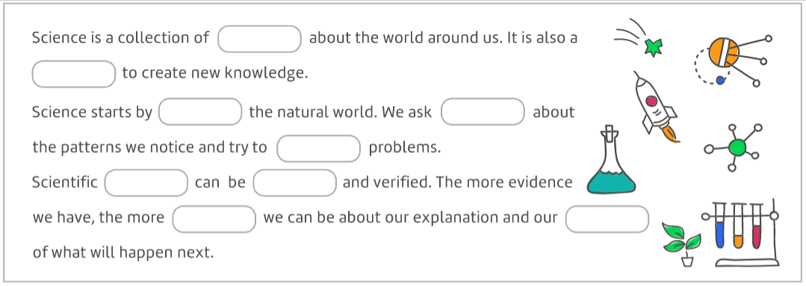
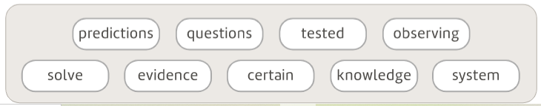
End
1
2
3
4
5
6
7
8
9
10
11
12
13
14
15
16
17
18
19
20
21
22
23
24
25
26
27
28
29
30
31
32
33
34
35
36
37
38
39
40
41
42
43
44
45
46
47
48
49
50
51
52
53
54
55
56
57
58
59
60
We will explore why we learn Science
Use what you have learnt from the video to fill in the gaps with your partner
Notes:
Scientists observe the natural world in search of patterns. When they think they've found one, they make a prediction that can be tested. The scientific method is a special way of testing predictions that usually involves careful observation and measurement.

Slide 12
We will explore why we learn Science
Branches of science
biology is the study of living things – "bio" means life
chemistry is the study of the different types of matter and how they combine
physics is the study of motion, forces and energy
Earth and space sciences is made up of two parts:
geology is the study of the Earth, including its rocks, oceans and atmosphere – "geo" means earth
astronomy is the study of other planets, stars, galaxies and the universe as a whole
TRACK WITH ME

Slide 13
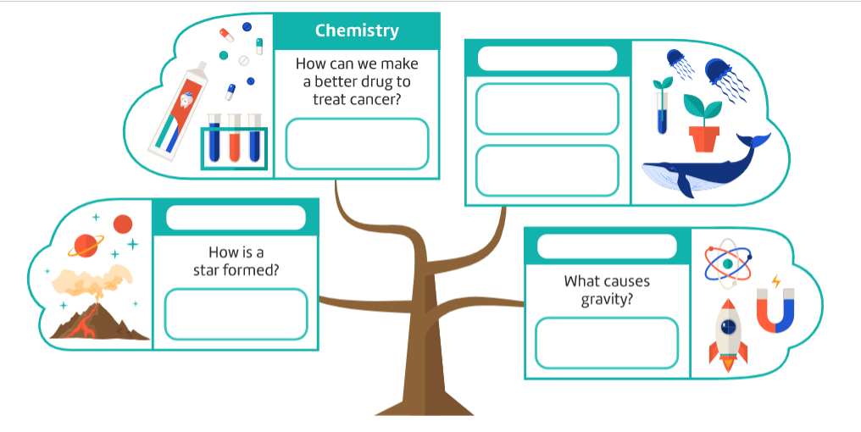
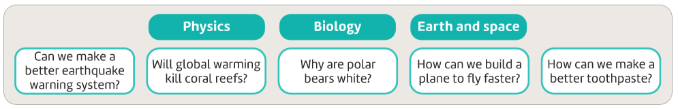
End
1
2
3
4
5
6
7
8
9
10
11
12
13
14
15
16
17
18
19
20
21
22
23
24
25
26
27
28
29
30
31
32
33
34
35
36
37
38
39
40
41
42
43
44
45
46
47
48
49
50
51
52
53
54
55
56
57
58
59
60
We will explore why we learn Science
Use what you have learnt to fill in the gaps with your partner
Notes:
Scientists observe the natural world in search of patterns. When they think they've found one, they make a prediction that can be tested. The scientific method is a special way of testing predictions that usually involves careful observation and measurement.

Slide 14
We will explore why we learn Science
Science in our everyday lives
It's easy to take technology for granted in our daily lives. But all of those things we rely on – from cars and computers to medicines and air conditioning – were made possible by scientific discoveries.
TRACK WITH ME
MAKE THE CONNECTION
What do you use at home or at school that has been improved by science or created with technology?

Slide 15
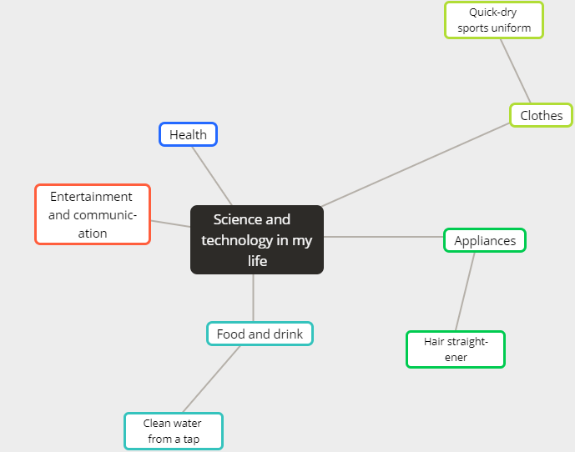

We will explore why we learn Science
Brainstorm examples of things you have in your life thanks to science and technology
MAKE THE CONNECTION
Just this morning I took painkillers for my headache, used an air conditioner to cool down, downloaded a new app…does all this use technology?
3 minutes

Slide 16
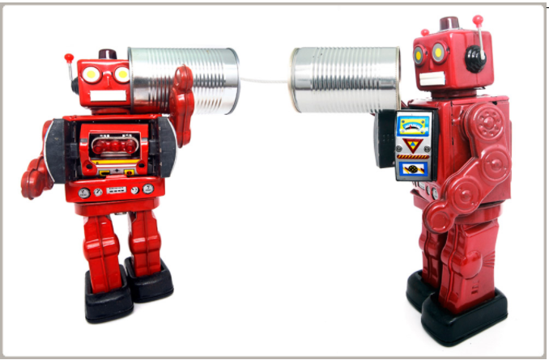
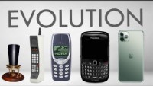
We will explore why we learn Science
The evolution of smartphones
Today, nearly half of the people in the world rely on smartphones in their daily lives. But how did they come about? It was through a long series of discoveries and improvements, each beginning with a question.
How can we speak to others across long distances?
How can we turn a voice into an electronic signal and then back into sound at the other end?
How can we send the signals further? Across countries? Between continents?
How can we remove cords from phones?
How can we make phones portable or "mobile"?
How can we make them smaller?
How can we fit in more features, such as cameras and calendars?

Slide 17
We will explore why we learn Science
The evolution of smartphones
Think Pair Share:
Describe how changes in science and technology have resulted in the smartphones we know today.
End
1
2
3
4
5
6
7
8
9
10
11
12
13
14
15
16
17
18
19
20
21
22
23
24
25
26
27
28
29
30
End
1
2
3
4
5
6
7
8
9
10
11
12
13
14
15
16
17
18
19
20
21
22
23
24
25
26
27
28
29
30
End
1
2
3
4
5
6
7
8
9
10
11
12
13
14
15
16
17
18
19
20
21
22
23
24
25
26
27
28
29
30

Slide 18
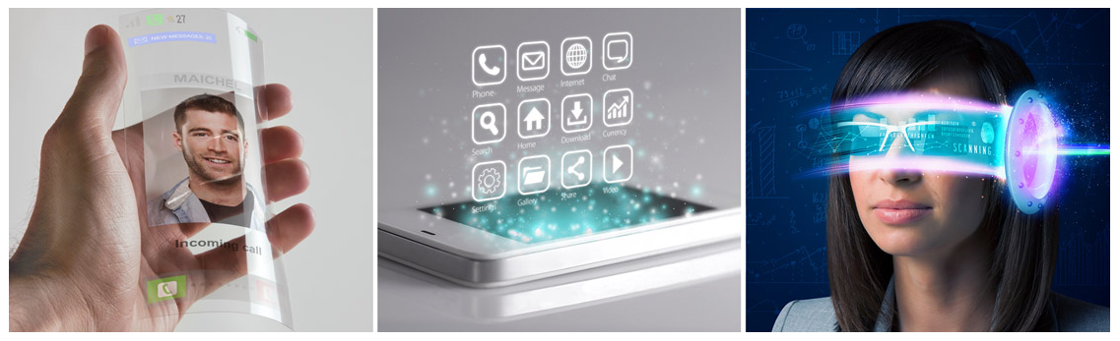
We will explore why we learn Science
The evolution of smartphones
Think Pair Share:
Think about what you would like your smartphone to be able to do in the future. What would you like it to look or feel like to use?
End
1
2
3
4
5
6
7
8
9
10
11
12
13
14
15
16
17
18
19
20
21
22
23
24
25
26
27
28
29
30
End
1
2
3
4
5
6
7
8
9
10
11
12
13
14
15
16
17
18
19
20
21
22
23
24
25
26
27
28
29
30
End
1
2
3
4
5
6
7
8
9
10
11
12
13
14
15
16
17
18
19
20
21
22
23
24
25
26
27
28
29
30

Slide 19
We will explore why we learn Science
TRACK WITH ME
READ WITH ME
We will describe the Science subject
We will separate Science into its branches
We will describe how science and technology impacts our lives
We will describe how scientists help us solve global issues
DECLARE THE OBJECTIVE
Read the learning objective to your partner.
Notes:
Learning Objectives contain concepts (nouns, big ideas), skills (verbs, measurable behaviours) and sometimes context (restricting or targeting conditions).
●Example: Students will be able to describe the concept of density and apply it to floating and sinking.
●
Success criteria are specific measurable outcomes that if met mean that the student has met the learning objective.
Examples:
•Students will be able to compare densities of substances using mass and volume.
•Students will be able to identify whether a solid or liquid will float or sink in a liquid based on their densities.

Slide 20

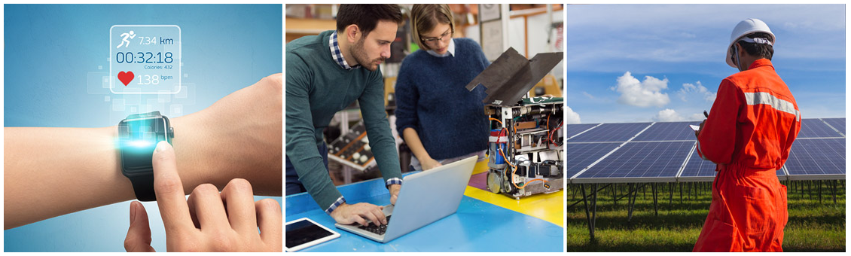
We will explore why we learn Science
Science solving global issues
What global issues is science currently trying to solve?

